Slide 1
Time Series Analysis in DNA Sequencing for Monitoring Disease Progression and Treatment Response
By – Ritik Roshan E23MCAG0012
Yatharth Aggarwal E23MCAG0051

Slide 2
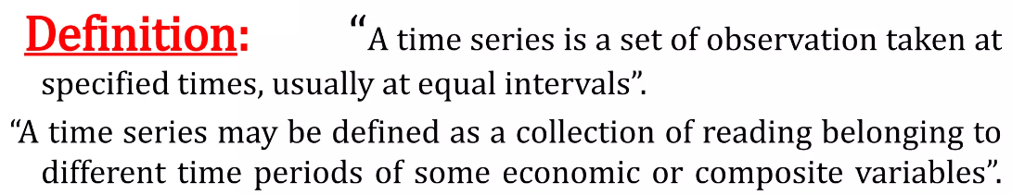
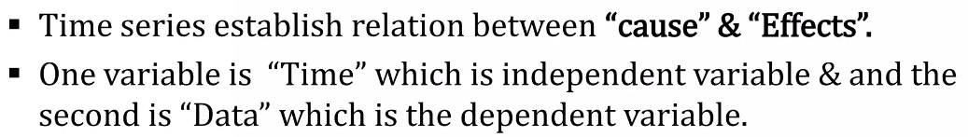
Introduction :-

Slide 3
Importance of Time Series Analysis
As the basis of time series analysis, it can predict about the changes in various categories. There are following points which clear about its importance :
Profit of experience. 5. Stock Market Analysis
Safety from future. 6. DNA Sequencing
Utility Studies
Sales Forecasting

Slide 4
DNA Sequencing
It is the process of determining the precise order of nucleotides within a DNA module.
It includes various methods or technology that is used to determine the order of the four bases A (Adenine), C (Cytosine), G (Guanine) and T (Thymine) molecules.

Slide 5
PURPOSE
Understanding the code of life.
Detecting mutations.
Typing microorganisms.
Identifying human haplotypes.
Designating Polymorphism

Slide 6
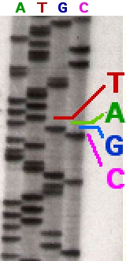
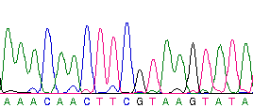
DNA Sequencing Methods
Historically there are two main methods:
Maxam and Gilbert Method.
Sanger Method
Automated Sequencing.

Slide 7
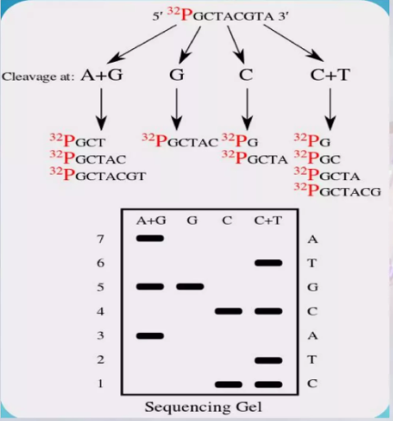
Maxam and Gilbert Method
This method was invented my A.M. Maxam and W. Gilbert in 1977.
Chemical sequencing.
Treatment of DNA with certain chemicals- DNA cuts into fragments- monitoring of sequences.

Slide 8
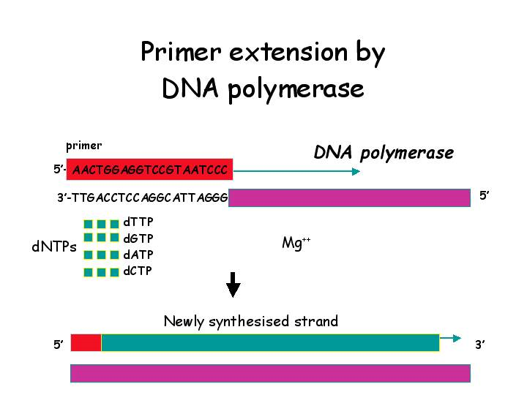
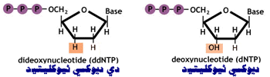
Sanger Method
A most common approach used for DNA sequencing.
Invented by Frederick Sanger in 1977 also known as Chain Termination method.
A technique for DNA sequencing based upon the selective incorporation of chain-terminating dideoxy nucleotides (ddNTPs) by DNA polymerase during in vitro DNA replication.

Slide 9
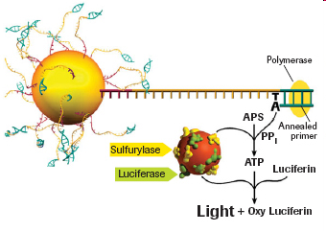
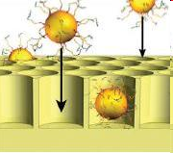
Applications of DNA Sequencing
Disease : To help identify individuals because each individual has different genetic sequence..
Human-Gene : The mapping and sequencing of the genome of microorganisms have helped to make them useful for human cell
Medicine : It can be used to help detect the genes which are linked to various genetic disorders such as muscular dystrophy

Slide 10
COMPARISONS
ADVANTAGES
Improved diagnosis of disease.
Bio – pesticides.
Identifying crime suspects.
Sequencing the whole Genome of organisms (e.g., Human genome project).
DIS-ADVANTAGES
Whole genome cannot be sequenced at once.
Very slow and time - consuming

Slide 11
PROBLEM STATEMENT
Patients with chronic illnesses often undergo long-term treatment regimens, and monitoring disease progression and treatment response over time is crucial for effective healthcare management. However, traditional methods for assessing disease progression and treatment response may lack granularity and fail to capture subtle changes over time. Therefore, there is a need for advanced analytical techniques, particularly time series analysis, to extract meaningful insights from longitudinal patient data.

Slide 12
CHALLENGES
Data Complexity.
Temporal Dynamics
Dimensionality Reduction
Model Selection and Interpretability
Data Integration

Slide 13
MODEL USED
LSTM
RNN
DNN

Slide 14
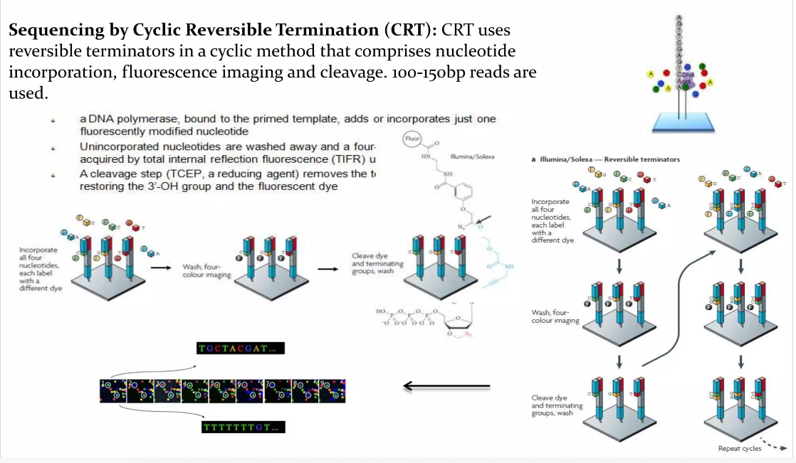
CRT Processing-

Slide 15
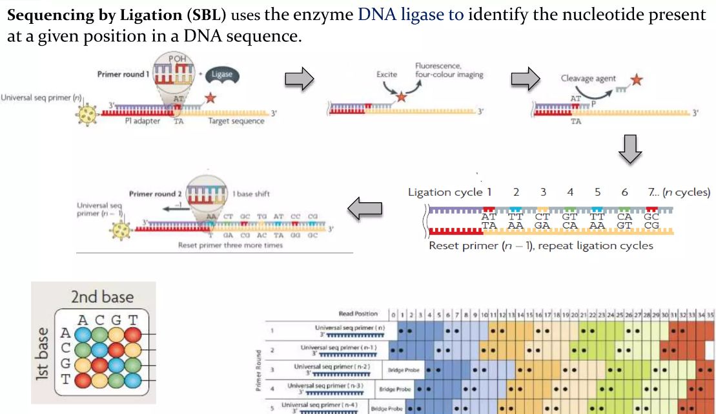
Sequencing-

Slide 16
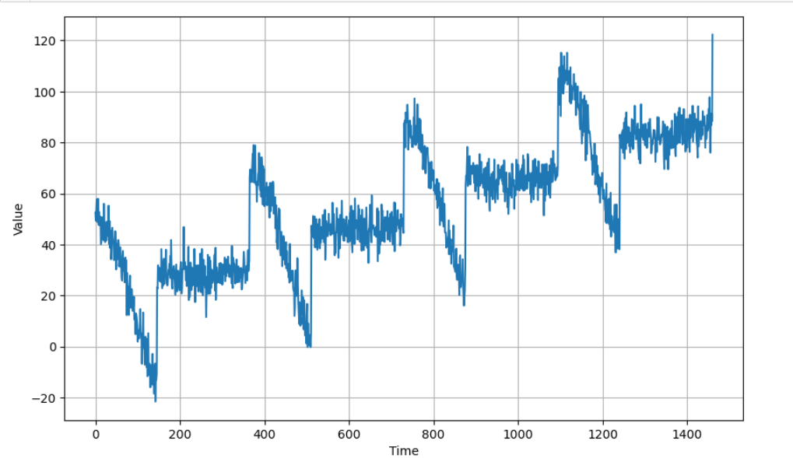
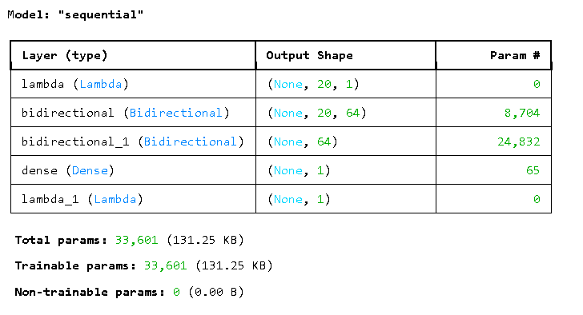
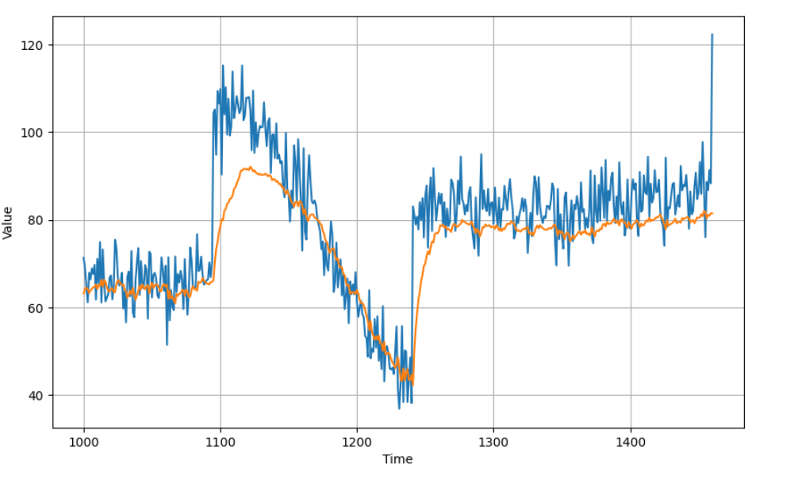
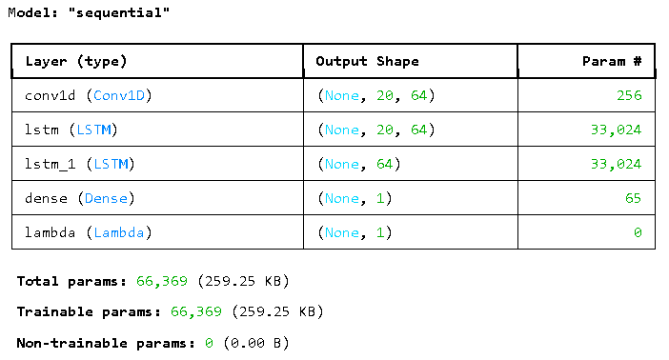
DATA PROGRESSION

Slide 17

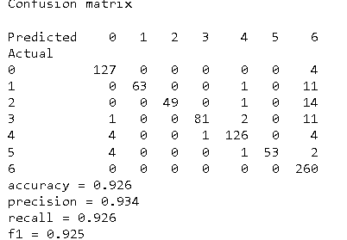
RESULT -

